Slide 1

Practical 25
Tree Traversal using Level Order Traversal

Slide 2

Lesson Plan
Subject/Course | Competitive Coding
Lesson Title | Tree Traversal using Level Order Traversal
Lesson Objectives
Understand the concept of Level Order Traversal in a binary tree.
Learn how to process tree nodes level by level using a queue.
Implement Level Order Traversal using Breadth-First Search (BFS) logic.
Analyze the time and space complexity of the algorithm for different tree structures.

Slide 3
Problem Statement:
Write a Program to Traverse a Tree using Level Order Traversal.

Slide 4
Concept
Level Order Traversal is based on Breadth-First Search (BFS).
We use a queue to store nodes of each level.
Nodes are visited in the order they appear in the queue.
Commonly used in shortest path problems and hierarchical data processing.

Slide 5
Algorithm/Logic
Steps:
Create an empty queue and enqueue the root node.
While the queue is not empty:
Dequeue a node, print its data.
Enqueue its left and right child (if present).
Continue until all nodes are processed.

Slide 6
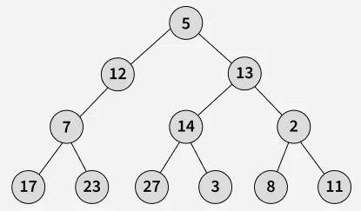
Visualization
Output: [[5], [12, 13], [7, 14, 2], [17, 23, 27, 3, 8, 11]]
Explanation: Start with the root - [5]
Level 1: [12, 13]
Level 2: [7, 14, 2]
Level 3: [17, 23, 27, 3, 8, 11]

Slide 7
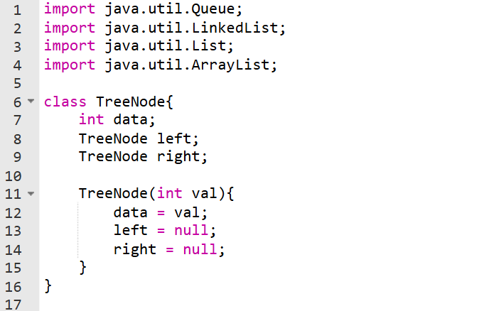
Code Implementation

Slide 8
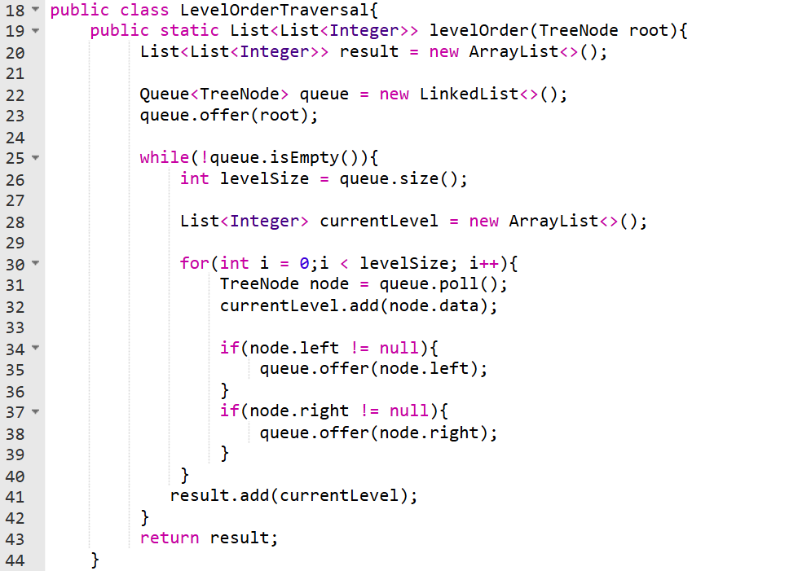
Code Implementation

Slide 9
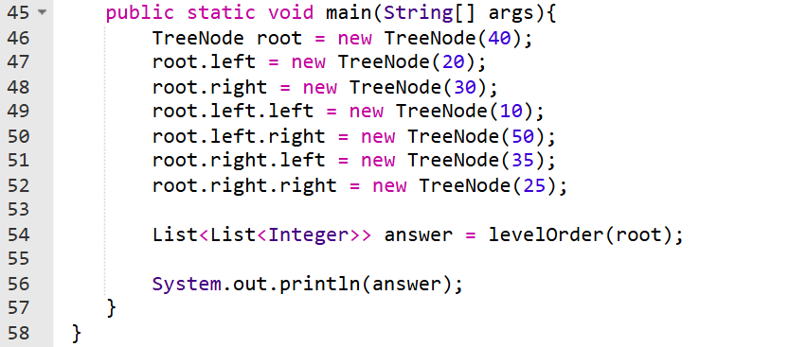
Code Implementation

Slide 10
Time & Space Complexity
Traversal Type | Time Complexity | Space Complexity | Approach
Level Order (BFS) | O(n) | O(n) | Queue-based BFS

Slide 11
Summary
Level Order Traversal visits all nodes level by level.
It uses a queue to maintain the processing order (BFS).
Ensures complete traversal of all levels before moving deeper.
Commonly used in shortest path, serialization, and organizational hierarchy problems.

Slide 12
Practice Questions:
1. Binary Tree Level Order Traversal — LeetCode #102 🔗 https://leetcode.com/problems/binary-tree-level-order-traversal/
Concept: Perform a level-wise traversal of a binary tree using BFS and return a list of nodes at each level.
Why Practice:
Builds understanding of queue-based traversal.
Helps in mastering breadth-first search concepts used across tree and graph problems.

Slide 13
Practice Questions:
2. Binary Tree Level Order Traversal II — LeetCode #107
🔗 https://leetcode.com/problems/binary-tree-level-order-traversal-ii/
Concept: Performs level order traversal but returns levels from bottom to top.
Why Practice: Enhances understanding of level-wise traversal manipulation and result ordering.

Slide 14
Practice Questions:
3. Average of Levels in Binary Tree — LeetCode #637
🔗 https://leetcode.com/problems/average-of-levels-in-binary-tree/
Concept: Uses level order traversal to compute the average value of nodes at each level.
Why Practice: Applies BFS traversal to real-world level-based aggregation problems.

Slide 15
Thanks

